Slide 1
Workshop on Population and Speciation Genomics, Cesky Krumlov SNP and genotype calling (and more) – Day 3
Matteo Fumagalli
January 27th 2016

Slide 2



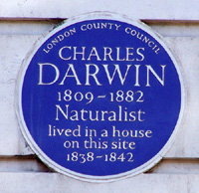
Who I am
PhD in Bioengineering
Polytechnic University of Milan, Italy
Postdoc (EMBO fellow)
Dept. Integrative Biology
Univ. of California, Berkeley, USA
R. Nielsen Group
Postdoc (HFSP fellow)
UCL Genetics Institute
University College London, UK
F. Balloux Group

Slide 3
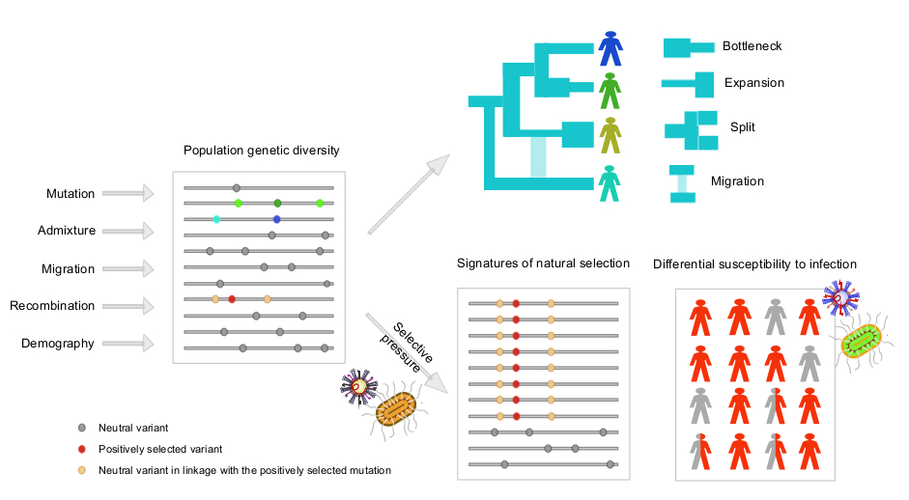
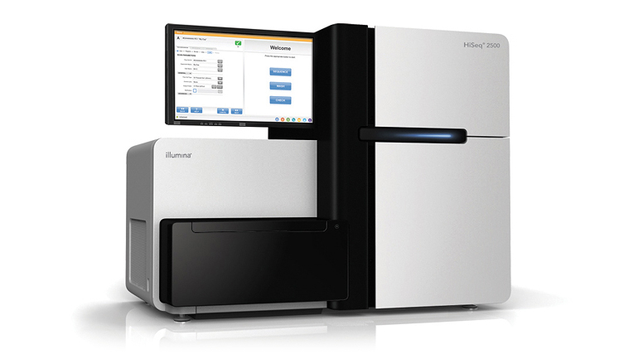
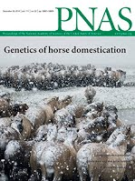

What I do
adapted from Fumagalli and Sironi, Current Opinion in Immunology, 2014

Slide 4
What I’ll be talking about today
Intro and basic filtering of NGS data
Genotype calling
SNP calling and estimation of allele frequencies
Advanced methods for population genetic analyses for low-depth data
Paper discussion
Intro to practical exercises
Bioinformatics
adapted from Fumagalli and Sironi, Current Opinion in Immunology, 2014

Slide 5
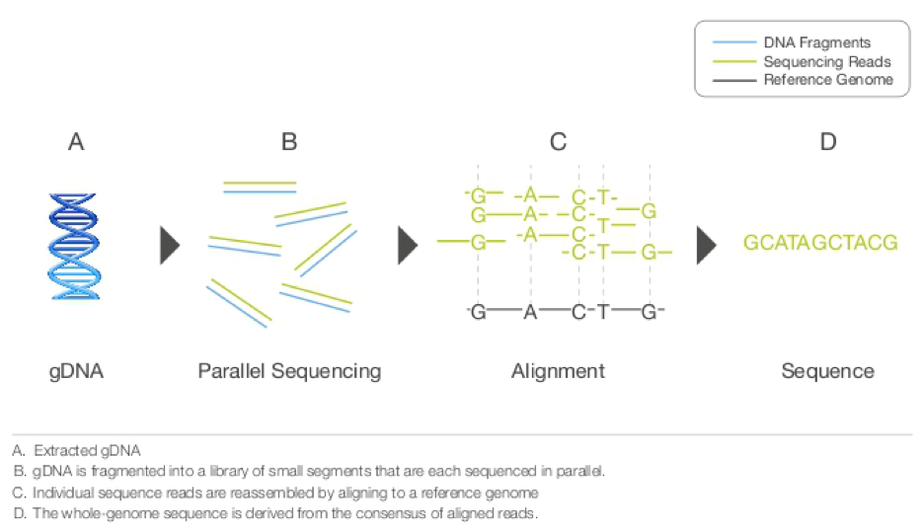
Next-Generation Sequencing

Slide 6
Different platforms
Technology | Read length | Gbp / day | Cost $/Mb
Sanger | 1 kb | 0.006 | ~ 500
454 | 450 bp | 0.5 | ~ 20
Solexa / Illumina | 2 x 100 bp | 25 | ~ 0.5
SOLiD | 2 x 50 bp | 10 | ~ 0.5
…
PacBio | 10 kb

Slide 7
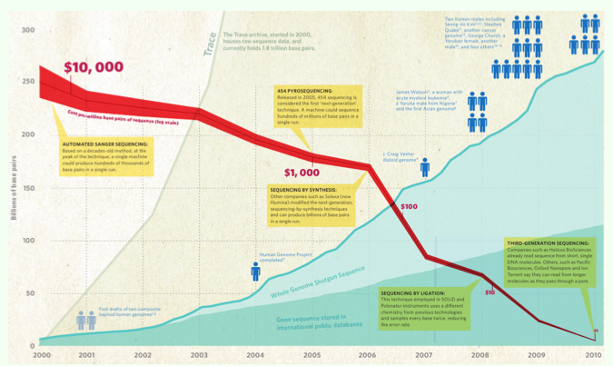
Sequencing cost

Slide 8
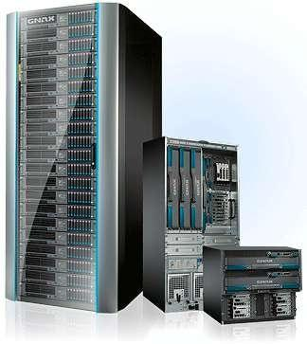
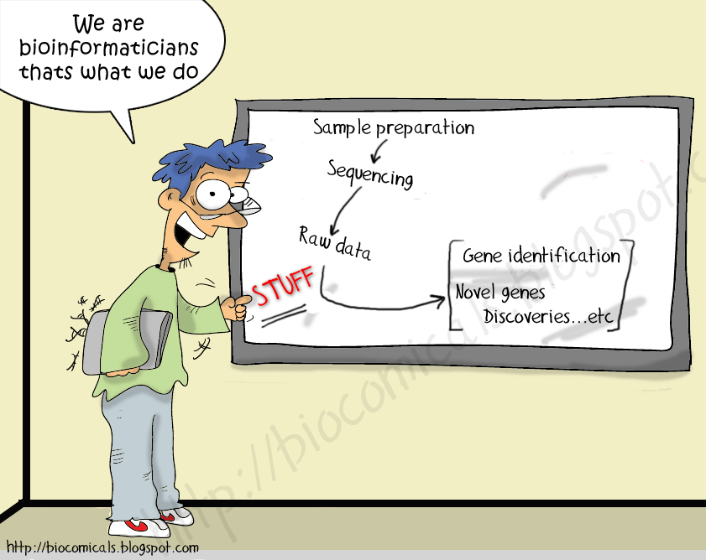
New costs

Slide 9
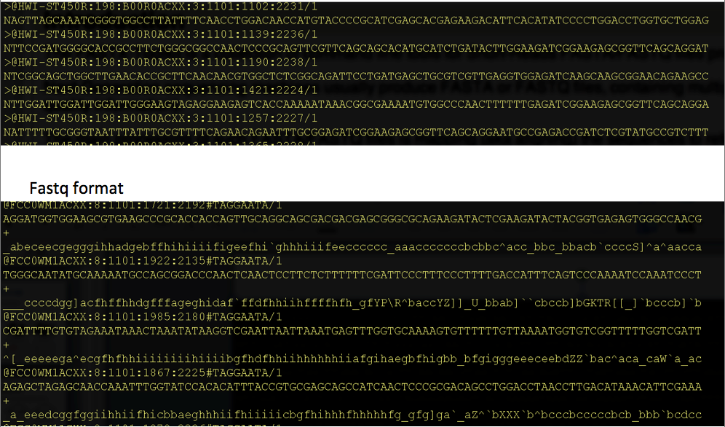
New data and new files

Slide 10
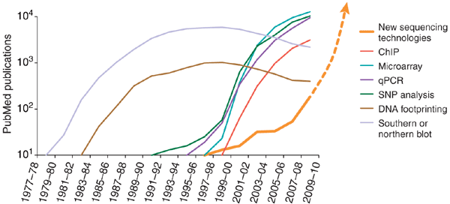
Usage of NGS
Avak Kahvejian, John Quackenbush & John F Thompson
Nature Biotechnology 26, 1125 - 1133 (2008)

Slide 11
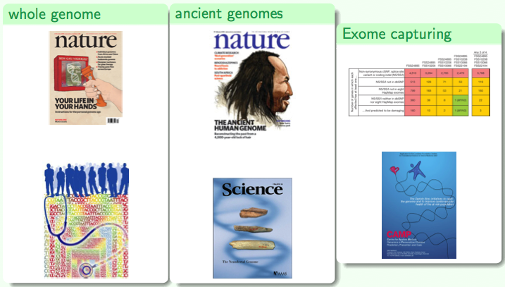
Applications

Slide 12
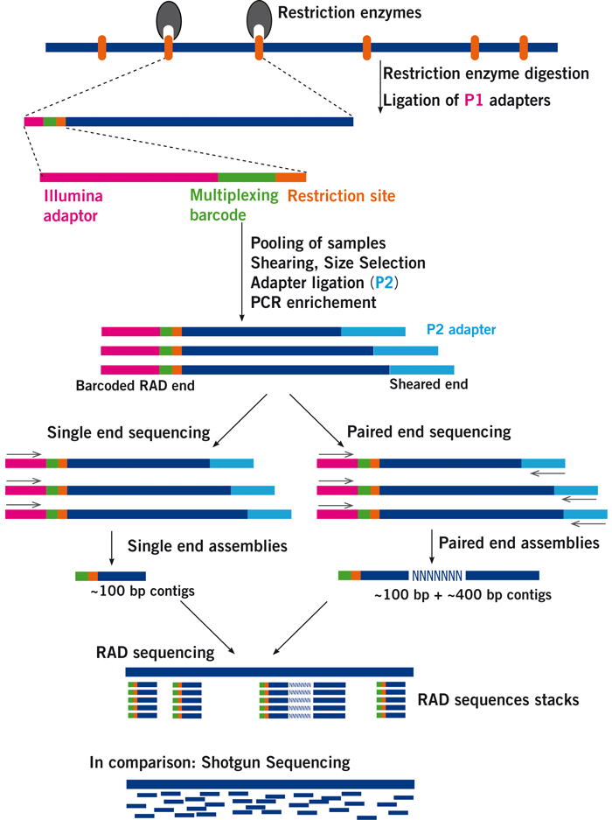
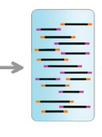
RAD-sequencing
Pooled
sequencing
…
http://www.floragenex.com/

Slide 13
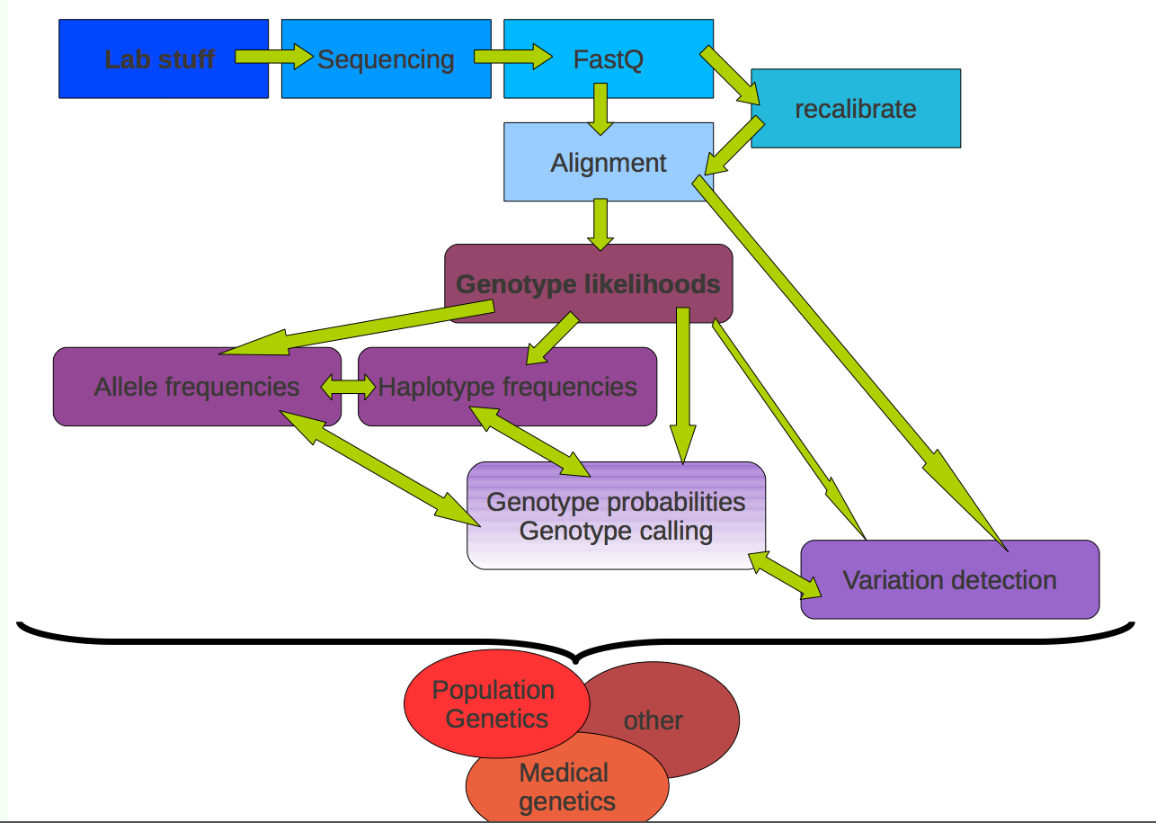
Workflow

Slide 14
Workflow
Low-level data:
Samples preparation + sequencing
Call bases and quality scores
Genotype data:
Call genotypes
Estimate allele/haplotype frequencies
SNPs detection
Analysis:
Population genetics analysis
Association studies

Slide 15
Workflow
Low-level data:
Samples preparation + sequencing
Call bases and quality scores
Genotype data:
Call genotypes
Estimate allele/haplotype frequencies
SNPs detection
Analysis:
Population genetics analysis
Association studies

Slide 16
Workflow
Low-level data:
Samples preparation + sequencing
Call bases and quality scores
Genotype data:
Call genotypes
Estimate allele/haplotype frequencies
SNPs detection
Analysis:
Population genetics analysis
Association studies

Slide 17
Workflow
Low-level data:
Samples preparation + sequencing
Call bases and quality scores
Genotype data:
Call genotypes
Estimate allele/haplotype frequencies
SNPs detection
Analysis:
Population genetics analysis
Association studies

Slide 18
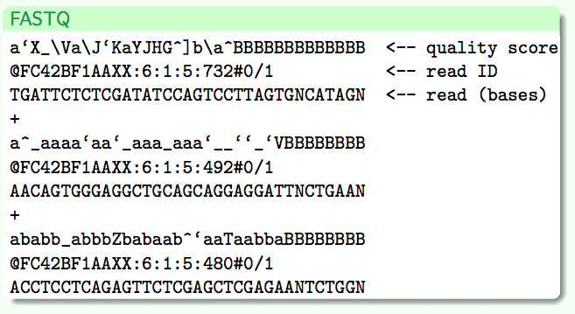
Low-level data

Slide 19
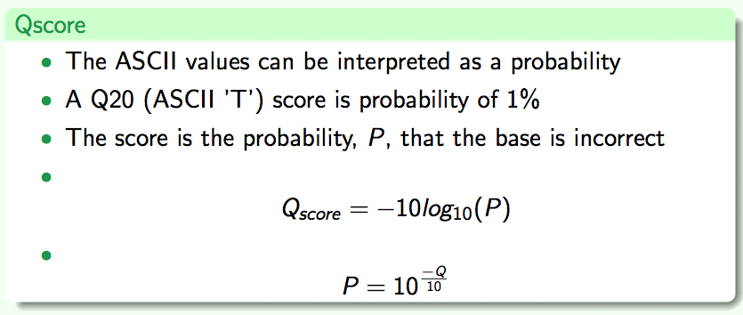
Quality scores
!"#$%&'()*+,-./0123456789:;⬄@ABCDEFGHIJKLMNOPQRSTUVWXYZ[\]^_`abcdefghijklmnopqrstuvwxyz{|}~

Slide 20
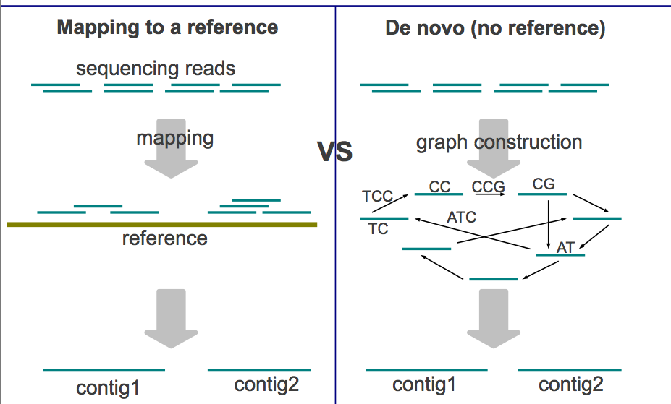
Assembly

Slide 21
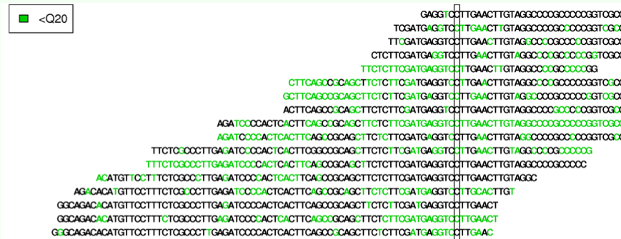
Mapped reads
Depth: number of reads mapped to a position
Counts: number of different alleles mapped to a position
Coverage: fraction of the genome with data

Slide 22
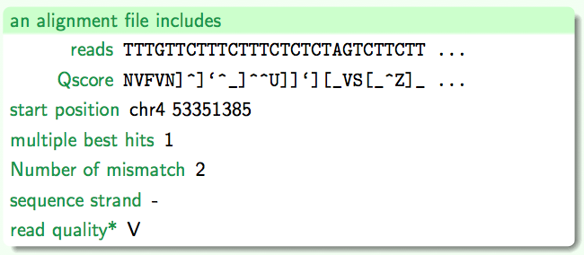
Alignment file

Slide 23
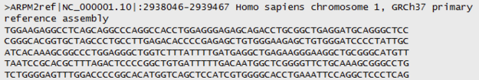
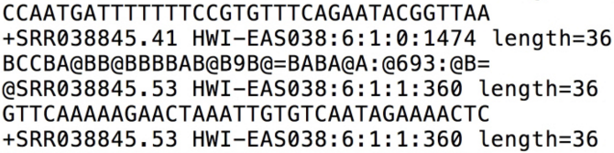
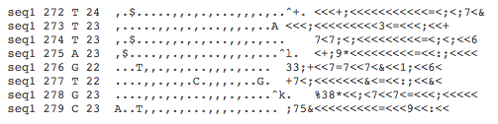
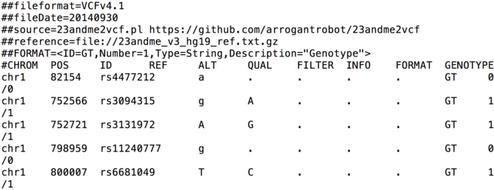
From genome to variants
Genome (FASTA)
Reads (FASTQ) Mapped Reads (mpileup, BAM)
Variants (VCF)

Slide 24
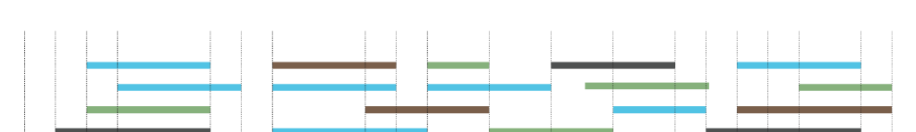
Challenges

Slide 25
Challenges
Variable and low depth
High sequencing and mapping errors

Slide 26
Challenges
Correct (?)
Strand bias
Allelic imbalance
A
A
A
A
A
G
A
G
G
A
A
A
A
G
A
G
A
A
G
G
A
G
A
A
G
G
A

Slide 27
Challenges
Variable and low depth
High sequencing and mapping errors
Quality control filters

Slide 28
Data filtering
Variable and low depth

Slide 29
Data filtering
Variable and low depth
Minimum depth
Maximum depth
Even depth across samples
…

Slide 30
Data filtering
Sequencing and mapping errors

Slide 31
Data filtering
Sequencing and mapping errors
Minimum base and mapping quality
Base quality bias
Deviation from Hardy-Weinberg Equilibrium (HWE)
…

Slide 32
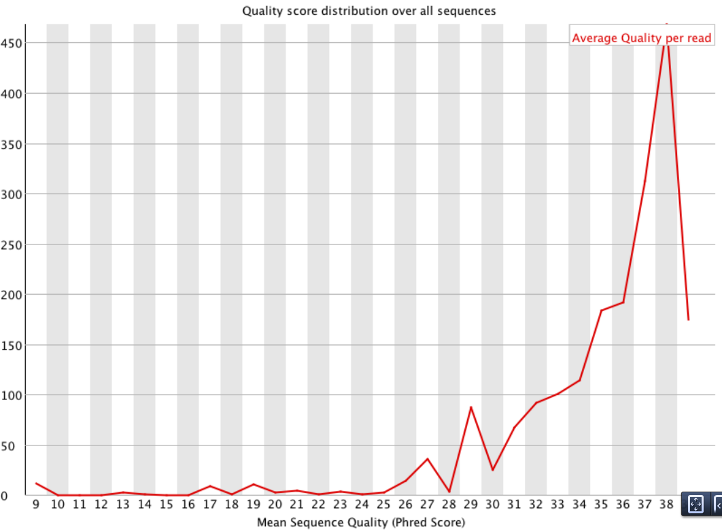
Check your filtering
Before filtering
Low quality data

Slide 33
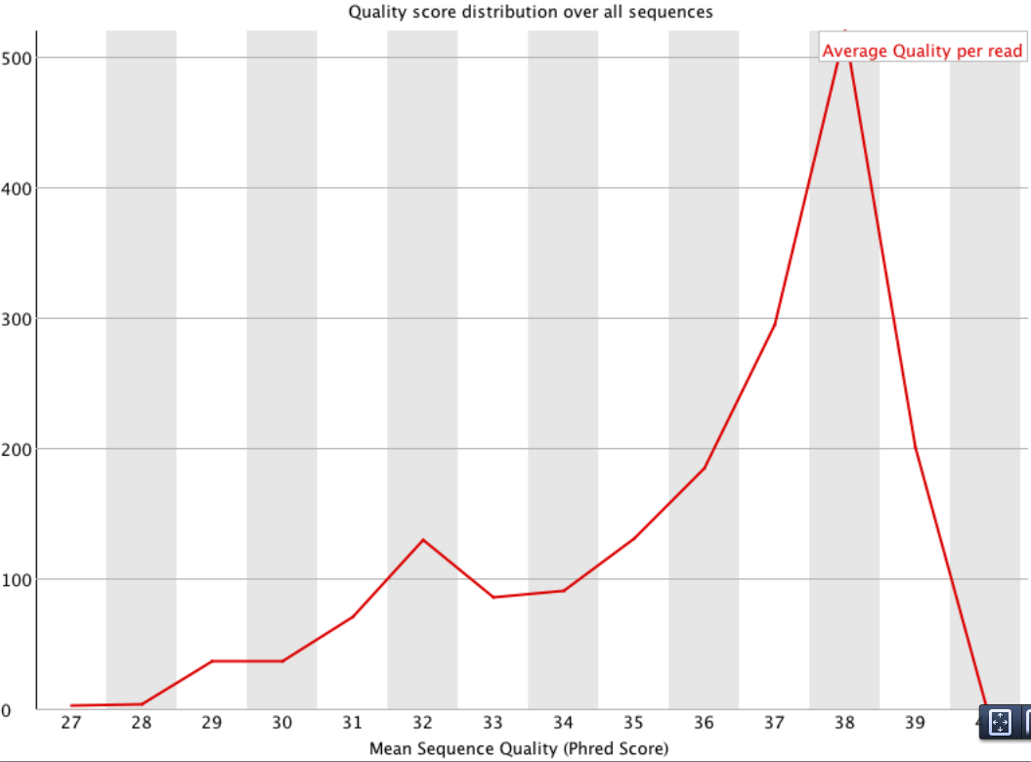
Check your filtering
After filtering

Slide 34
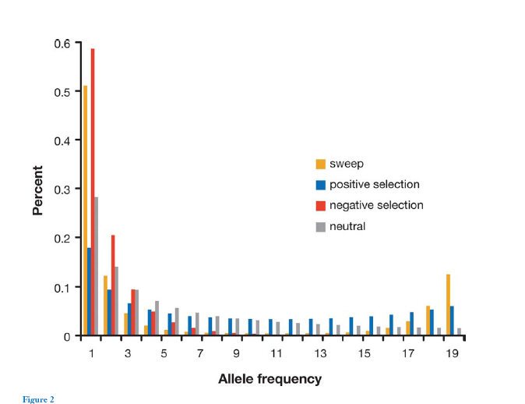
Site Frequency Spectrum (SFS)

Slide 35
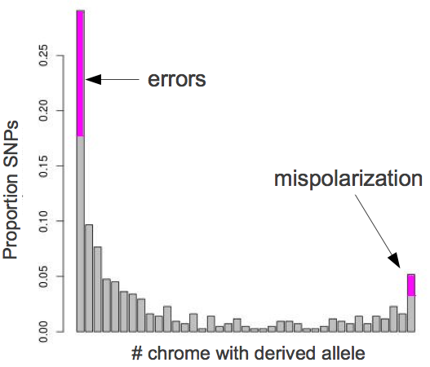
Effect of errors on the SFS
?
?

Slide 36
Effect of errors on the SFS
Sequencing errors
?
?

Slide 37
Effect of errors on the SFS
Remove low quality/depth sites.
Stricter SNP calling.
Remove aberrant individuals
Sequencing errors
?

Slide 38
Effect of errors on the SFS
Remove low quality/depth sites.
Stricter SNP calling.
Remove aberrant individuals
Sequencing errors
Mispolarization

Slide 39
Effect of errors on the SFS
Remove low quality/depth sites.
Stricter SNP calling.
Remove aberrant individuals
Sequencing errors
Check your outgroup.
Use folded data.
Mispolarization

Slide 40
Filtering pipeline
Dependency on your data and goals
Check intermediate files and Site Frequency Spectrum
Tune your parameters by iterating multiple times if necessary

Slide 41
Workflow
Low-level data:
Samples preparation + sequencing
Call bases and quality scores
Genotype data:
Call genotypes
Estimate allele/haplotype frequencies
SNPs detection
Analysis:
Population genetics analysis
Association studies

Slide 42
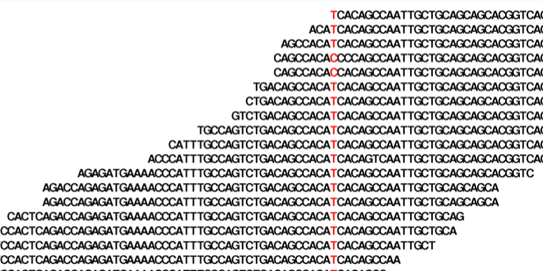
Genotypes calling
Sanger: both alleles are amplified and sequenced at the same time
NGS: each allele is sequenced separately and sampled with replacement

Slide 43
Likelihood
P(Data | Parameter = Value)
Maximum Likelihood Estimate (MLE):
from a set of observation, identify the value for the parameter (to be estimated) that maximize the likelihood of observing the data.
The integral of the likelihood function is not (always) 1.

Slide 44
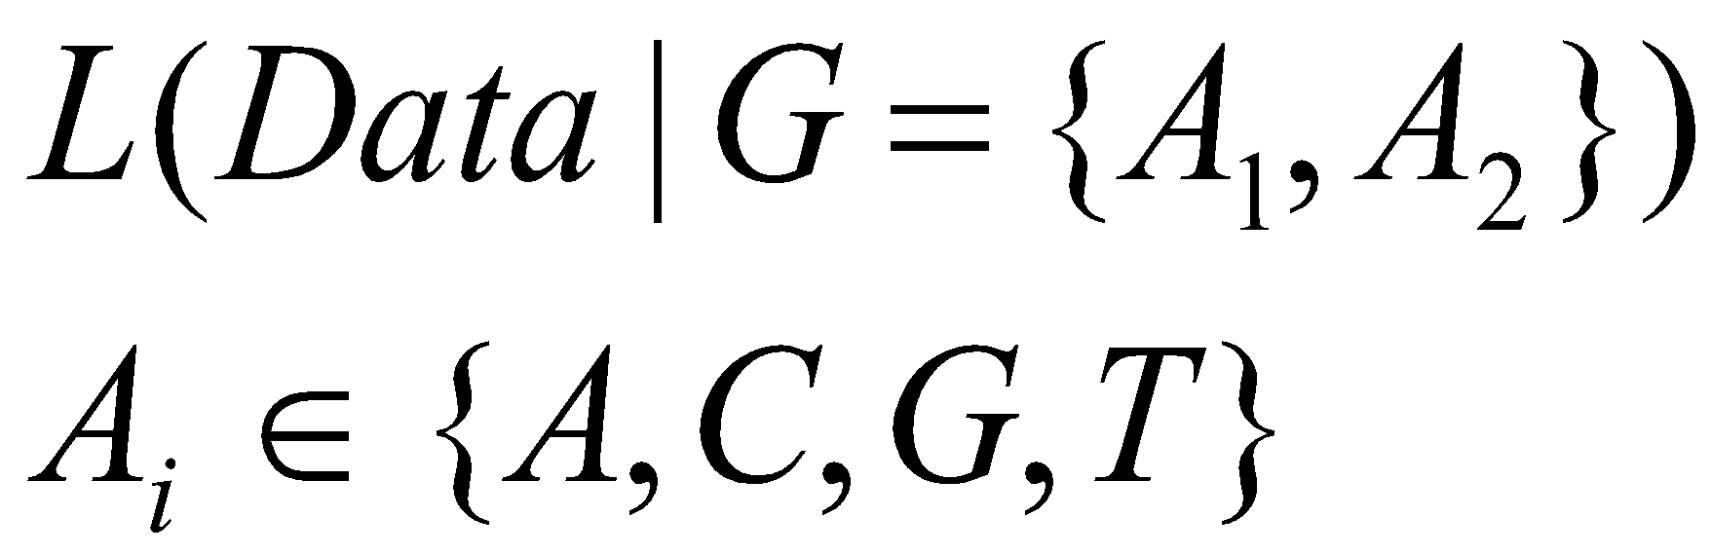
Genotype likelihoods
How many genotype likelihoods do we have for each individual at each site?

Slide 45
Genotype likelihoods
How many genotype likelihoods do we have for each individual at each site?
3 if both alleles are known
10 if not

Slide 46
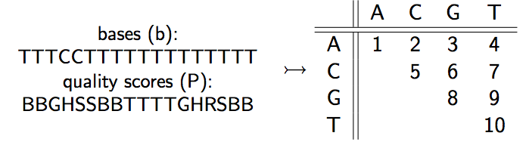
Genotype likelihoods
Summarize the reads data in 10 genotype likelihoods:

Slide 47
Genotype likelihoods
SAMtools (H Li et al., 2008): quality scores, quality dependency
soapSNP (R Li et al., 2009): quality scores, quality dependency
GATK (McKenna et al, 2010): quality scores
Kim et al. (2011): type specific errors
…

Slide 48
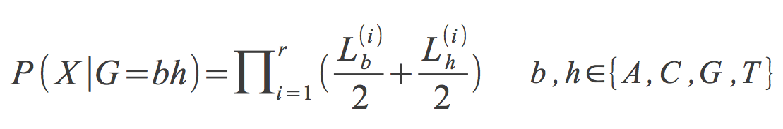
Calculating genotype likelihoods

Slide 49
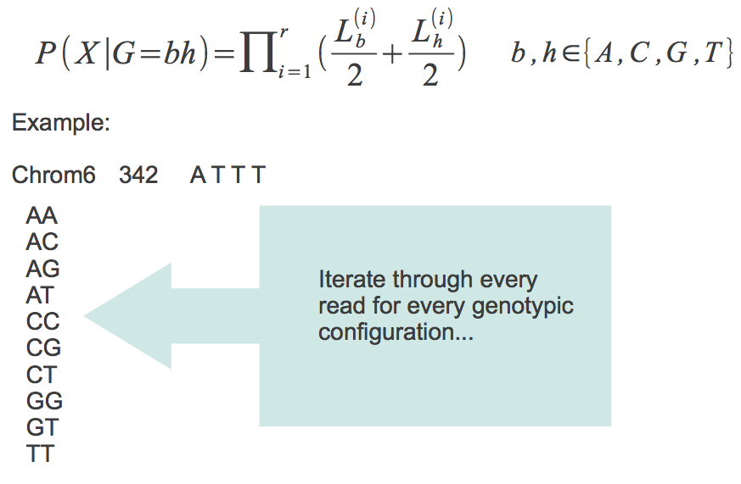
Calculating genotype likelihoods
A
T
T
T
Individual 1
T
T
Individual 2
A
A
T
T
Individual 3

Slide 50
Calculating genotype likelihoods

Slide 51
Calculating genotype likelihoods

Slide 52
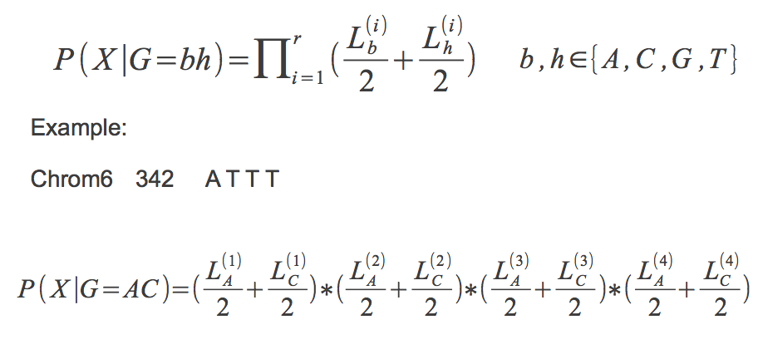
Calculating genotype likelihoods

Slide 53
Calculating genotype likelihoods

Slide 54
Calculating genotype likelihoods

Slide 55
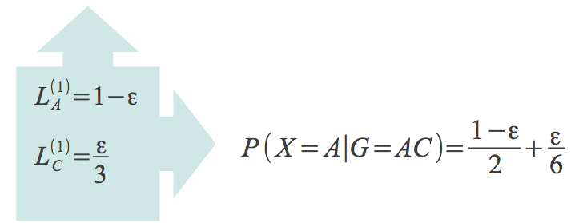
Calculating genotype likelihoods

Slide 56
Calculating genotype likelihoods

Slide 57
Calculating genotype likelihoods

Slide 58
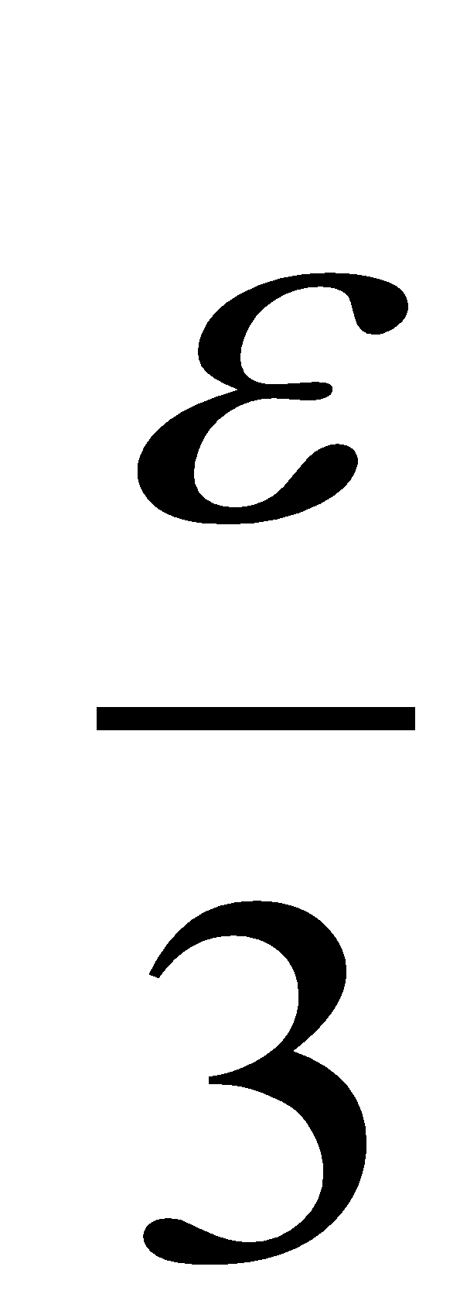
Calculating genotype likelihoods

Slide 59
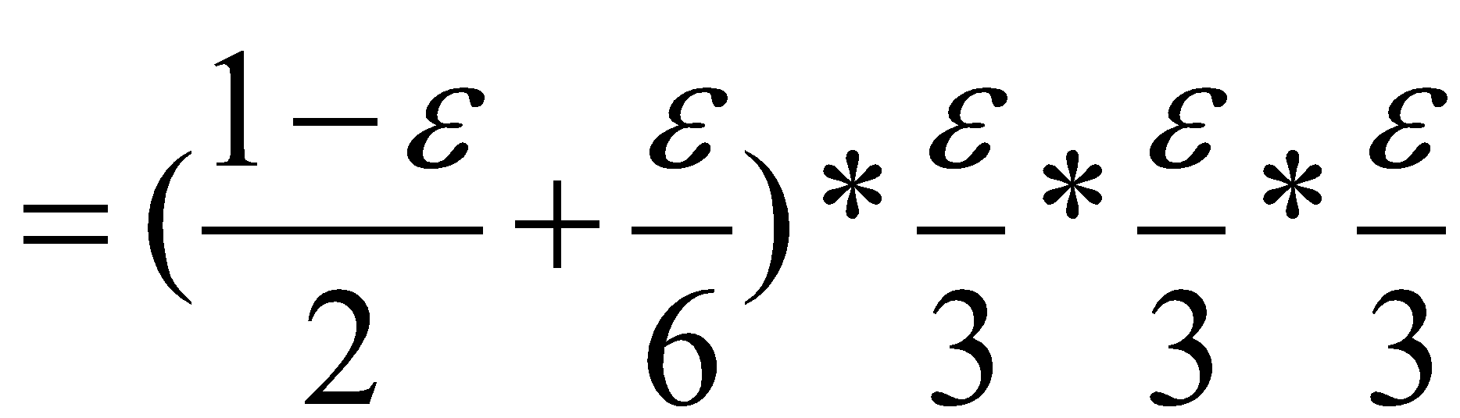
Calculating genotype likelihoods

Slide 60
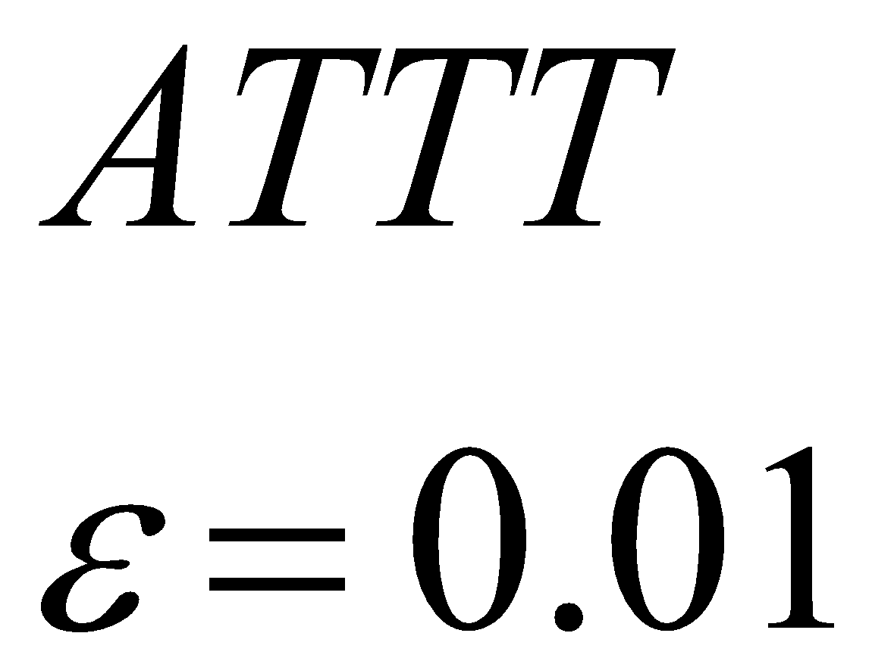
Genotype likelihoods
Genotype | Likelihood (log10)
AA | -7.44
AC | -7.74
AG | -7.74
AT | -1.22
CC | -9.91
CG | -9.91
CT | -3.38
GG | -9.91
GT | -3.38
TT | -2.49

Slide 61
Genotype calling
Genotype | Likelihood (log10)
AA | -7.44
AC | -7.74
AG | -7.74
AT | -1.22
CC | -9.91
CG | -9.91
CT | -3.38
GG | -9.91
GT | -3.38
TT | -2.49
What is the genotype here?

Slide 62
Genotype calling
Genotype | Likelihood (log10)
AA | -7.44
AC | -7.74
AG | -7.74
AT | -1.22
CC | -9.91
CG | -9.91
CT | -3.38
GG | -9.91
GT | -3.38
TT | -2.49
Simple genotype caller:
Maximum Likelihood
Choose the genotype with the largest likelihood
AT

Slide 63
Genotype calling
Simple genotype caller:
Maximum Likelihood
But only call the genotype if the largest likelihood is much better than the second best
Genotype | Likelihood (log10)
AA | -7.44
AC | -7.74
AG | -7.74
AT | -1.22
CC | -9.91
CG | -9.91
CT | -3.38
GG | -9.91
GT | -3.38
TT | -2.49

Slide 64
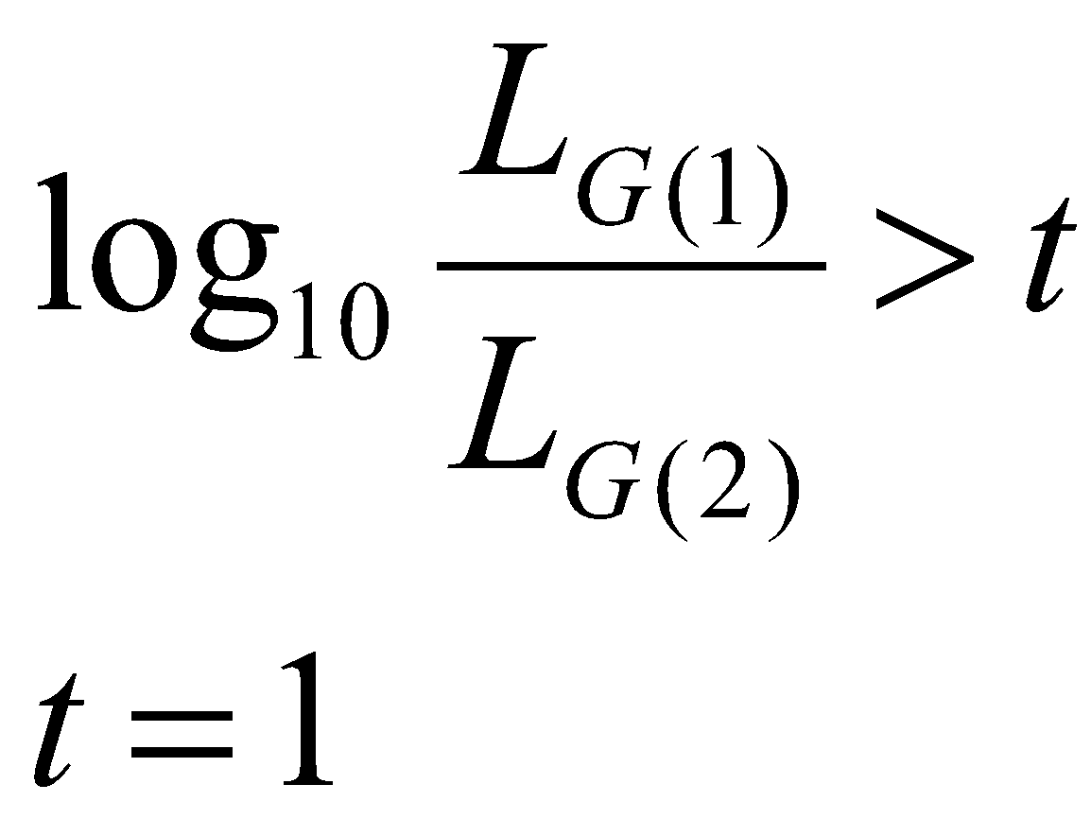
Genotype calling
Likelihood Ratio:
The most likely genotype is at least 10 times more likely than the second most likely one
(in our example t=1.27)

Slide 65
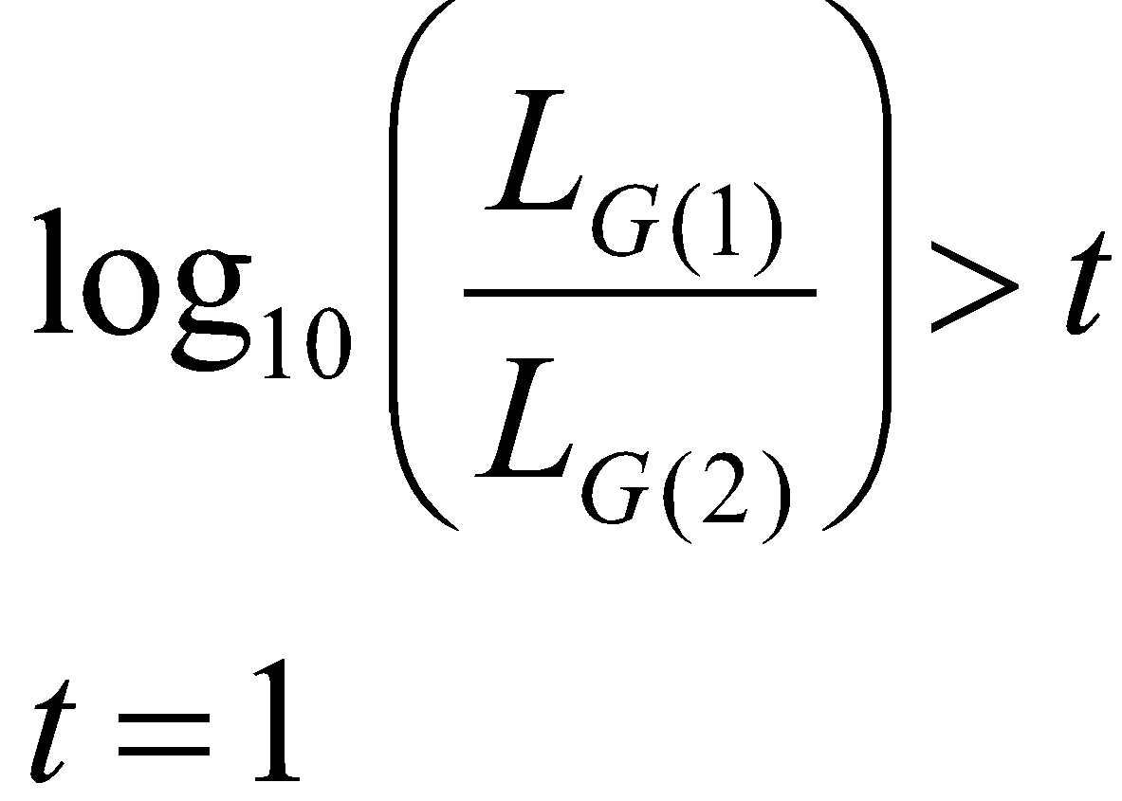
Genotype calling
Likelihood Ratio:
The most likely genotype is at least 10 times more likely than the second most likely one
Higher confidence of called genotypes
More missing data

Slide 66
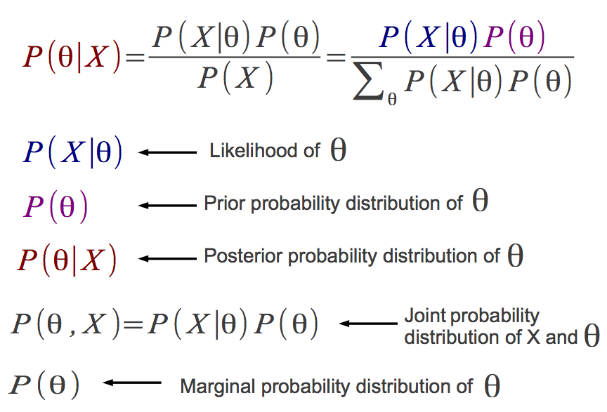
Bayesian inference

Slide 67
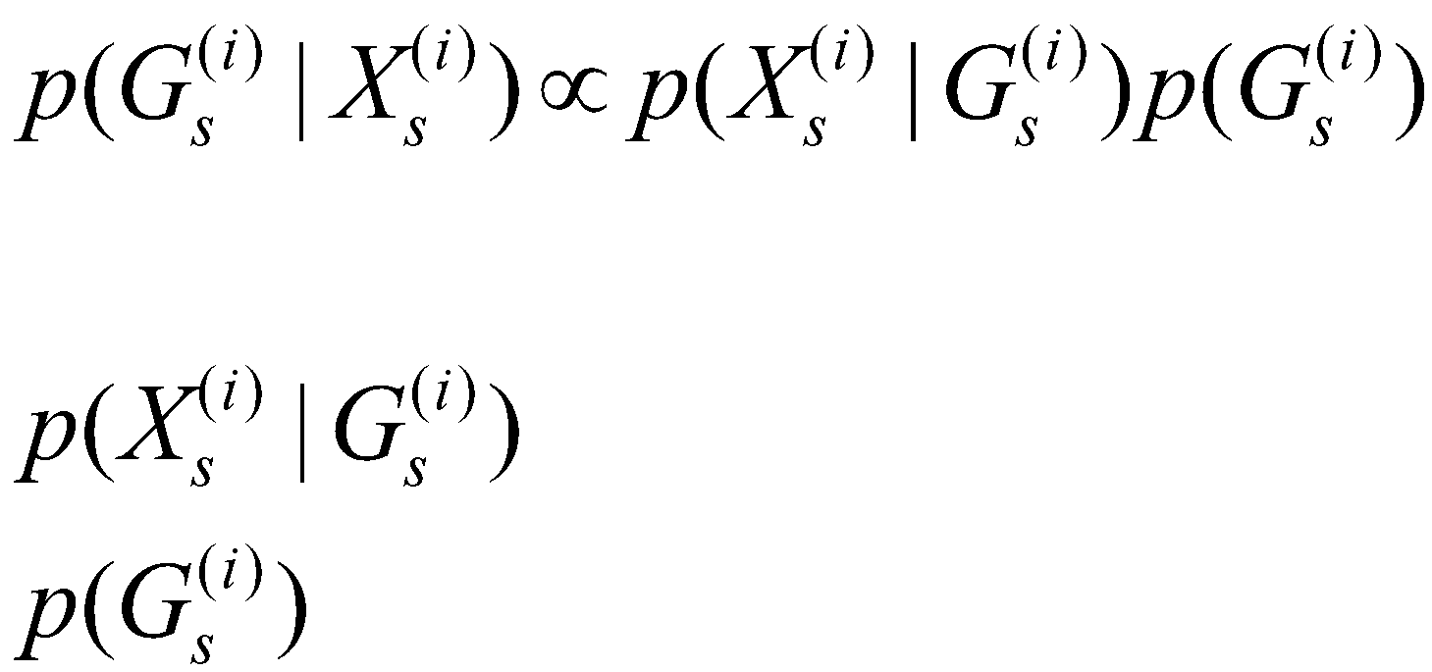
Genotype posterior probabilities
Genotype likelihood
Prior

Slide 68
Genotype posterior probabilities
Genotype | Likelihood (log10) | Prior | Posterior probability
AA | -7.44 | 1/10 | ~ 0
AC | -7.74 | 1/10 | ~ 0
AG | -7.74 | 1/10 | ~ 0
AT | -1.22 | 1/10 | 0.94
CC | -9.91 | 1/10 | ~ 0
CG | -9.91 | 1/10 | ~ 0
CT | -3.38 | 1/10 | 0.006
GG | -9.91 | 1/10 | ~ 0
GT | -3.38 | 1/10 | 0.006
TT | -2.49 | 1/10 | 0.05
Simple genotype caller:
Bayesian
AT

Slide 69
Genotype posterior probabilities
Genotype | Likelihood (log10) | Prior | Posterior probability
AA | -7.44 | 1/10 | ~ 0
AC | -7.74 | 1/10 | ~ 0
AG | -7.74 | 1/10 | ~ 0
AT | -1.22 | 1/10 | 0.94
CC | -9.91 | 1/10 | ~ 0
CG | -9.91 | 1/10 | ~ 0
CT | -3.38 | 1/10 | 0.006
GG | -9.91 | 1/10 | ~ 0
GT | -3.38 | 1/10 | 0.006
TT | -2.49 | 1/10 | 0.05
Simple genotype caller:
Bayesian
But only call the genotype if the largest probability is above a threshold (e.g. > 0.95)

Slide 70
Genotype posterior probabilities
Simple genotype caller:
Bayesian
P(A) = 0.9 if A is the reference allele;
P(A) = 0.1 otherwise
Example: reference is T
P(TT) = P(A)²
Genotype | Likelihood (log10) | Prior | Posterior probability
AA | -7.44 | 0.01 | ~ 0
AC | -7.74 | 0.01 | ~ 0
AG | -7.74 | 0.01 | ~ 0
AT | -1.22 | 0.09 | 0.67
CC | -9.91 | 0.01 | ~ 0
CG | -9.91 | 0.01 | ~ 0
CT | -3.38 | 0.09 | 0.005
GG | -9.91 | 0.01 | ~ 0
GT | -3.38 | 0.09 | 0.0005
TT | -2.49 | 0.81 | 0.32
AT (?)

Slide 71
Genotype posterior probabilities
Better genotype caller:
Bayesian
P(A) = f
Where f (=0.75) is the allele frequency from a reference panel
Example: reference is T
P(TT) = …
P(AT) = …
P(AA) = …
Genotype | Likelihood (log10) | Prior | Posterior probability
AA | -7.44
AC | -7.74
AG | -7.74
AT | -1.22
CC | -9.91
CG | -9.91
CT | -3.38
GG | -9.91
GT | -3.38
TT | -2.49

Slide 72
Genotype posterior probabilities
Better genotype caller:
Bayesian
P(A) = f
Where f (=0.75) is the allele frequency from a reference panel
Example: reference is T
P(TT) = f²
P(AT) = …
P(AA) = …
Genotype | Likelihood (log10) | Prior | Posterior probability
AA | -7.44
AC | -7.74
AG | -7.74
AT | -1.22
CC | -9.91
CG | -9.91
CT | -3.38
GG | -9.91
GT | -3.38
TT | -2.49 | 0.56

Slide 73
Genotype posterior probabilities
Better genotype caller:
Bayesian
P(A) = f
Where f (=0.75) is the allele frequency from a reference panel
Example: reference is T
P(TT) = f²
P(AT) = 2f(1-f)
P(AA) = …
Genotype | Likelihood (log10) | Prior | Posterior probability
AA | -7.44
AC | -7.74
AG | -7.74
AT | -1.22 | 0.38
CC | -9.91
CG | -9.91
CT | -3.38
GG | -9.91
GT | -3.38
TT | -2.49 | 0.56

Slide 74
Genotype posterior probabilities
Better genotype caller:
Bayesian
P(A) = f
Where f is the allele frequency from a reference panel
Example: reference is T
P(TT) = f²
P(AT) = 2f(1-f)
P(AA) = (1-f)²
Assuming f=0.75 and only A and T alleles
Genotype | Likelihood (log10) | Prior | Posterior probability
AA | -7.44 | 0.06 | ~ 0
AC | -7.74 | 0 | 0
AG | -7.74 | 0 | 0
AT | -1.22 | 0.38 | 0.93
CC | -9.91 | 0 | 0
CG | -9.91 | 0 | 0
CT | -3.38 | 0 | 0
GG | -9.91 | 0 | 0
GT | -3.38 | 0 | 0
TT | -2.49 | 0.56 | 0.07

Slide 75
Genotype posterior probabilities
Genotype | Likelihood (log10) | Prior | Posterior probability
AA | -7.44 | 0.16 | ~ 0
AC | -7.74 | 0 | 0
AG | -7.74 | 0 | 0
AT | -1.22 | 0.48 | 0.96
CC | -9.91 | 0 | 0
CG | -9.91 | 0 | 0
CT | -3.38 | 0 | 0
GG | -9.91 | 0 | 0
GT | -3.38 | 0 | 0
TT | -2.49 | 0.36 | 0.38
Better genotype caller:
Empirical Bayesian
P(A) = f
Where f is the allele frequency estimated from the data itself
With f=0.6

Slide 76
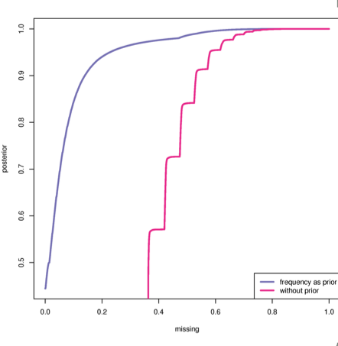
Missing data
Mean depth 8X
Prior | Threshold | Missing data rate
No | 99% | 70%
No | 99.9% | 80%
Allele frequency | 99% | 50%
Allele frequency | 99.9% | 65%
Threshold on genotype
Posterior probabilities
Missing data rate
Notes:
Why we don’t want to call genotypes!

Slide 77
Summary
Data filtering should be performed keeping in mind your goals and specific features of your data.
There is no unique perfect pipeline.
Check your intermediate results and tune your parameters iteratively.
Genotype calling should be performed including information from all samples.

Slide 78
Software
All these methods have been implemented in several software and utilities, such as:
SAMtools (http://samtools.sourceforge.net)
GATK (https://www.broadinstitute.org/gatk)
ANGSD (http://popgen.dk/ANGSD)
freebayes (https://github.com/ekg/freebayes)

Slide 79
Practical session using ANGSD (SAMtools)
File formats
Data filtering
Assessing your filtering
Genotype calling

Slide 80
Workflow
Low-level data:
Samples preparation + sequencing
Call bases and quality scores
Genotype data:
Call genotypes
Estimate allele frequencies
SNPs detection
Analysis:
Population genetics analysis
Association studies

Slide 81
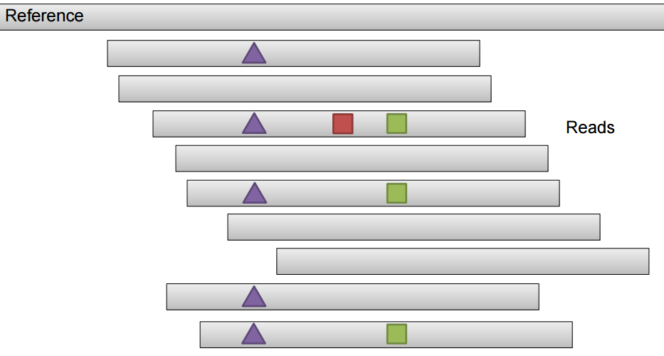
SNP calling procedures
Alignment-based caller
We completely rely on how reads have been mapped
Figure from Erik Garrison

Slide 82
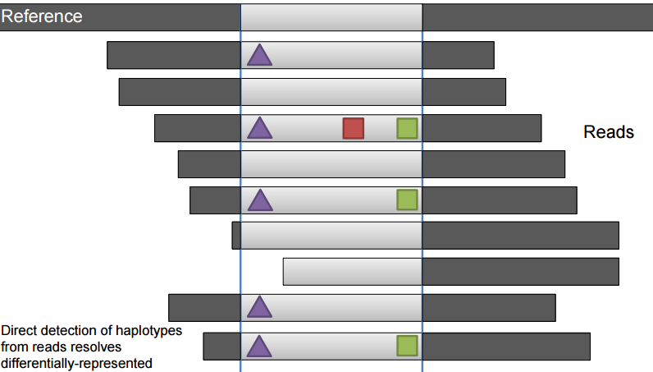
SNP calling procedures
Assembly-based caller (as in GATK)
Local re-alignement around putative variants; better resolution for INDELs detection.
Haplotype-based caller (as in freebayes)
Figure from Erik Garrison

Slide 83
Estimating allele frequencies
Individual | True genotype | Reads allele A | Reads allele G
1 | AA
2 | AA
3 | AG
4 | AG
5 | GG
6 | GG
Tot.
Assume only 2 allelic types
True allele frequency is 0.50

Slide 84
Estimating allele frequencies
Individual | True genotype | Reads allele A | Reads allele G
1 | AA | 7 | 0
2 | AA | 25 | 1
3 | AG | 5 | 3
4 | AG | 4 | 4
5 | GG | 0 | 2
6 | GG | 0 | 4
Tot. |  | 41 | 14
Assume only 2 allelic types
True allele frequency is 0.50

Slide 85
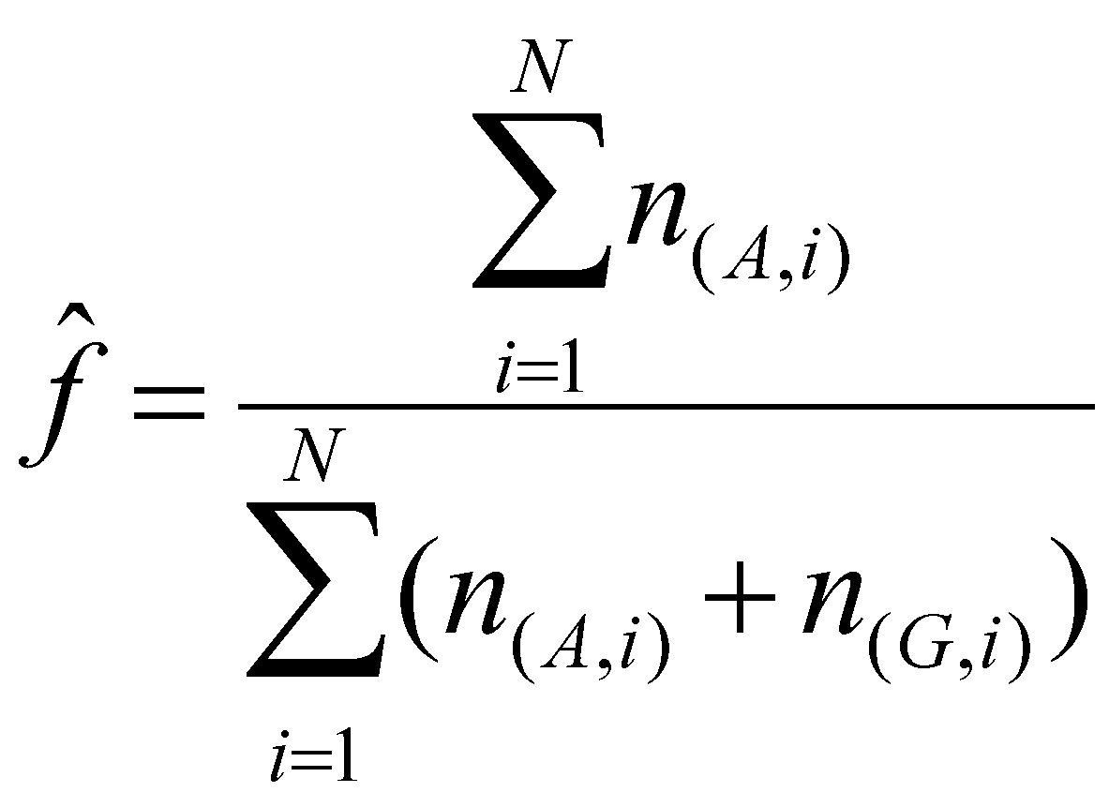
Estimating allele frequencies
Individual | True genotype | Reads allele A | Reads allele G
1 | AA | 7 | 0
2 | AA | 25 | 1
3 | AG | 5 | 3
4 | AG | 4 | 4
5 | GG | 0 | 2
6 | GG | 0 | 4
Tot. |  | 41 | 14
Simple allele frequency estimator:
from reads counts

Slide 86
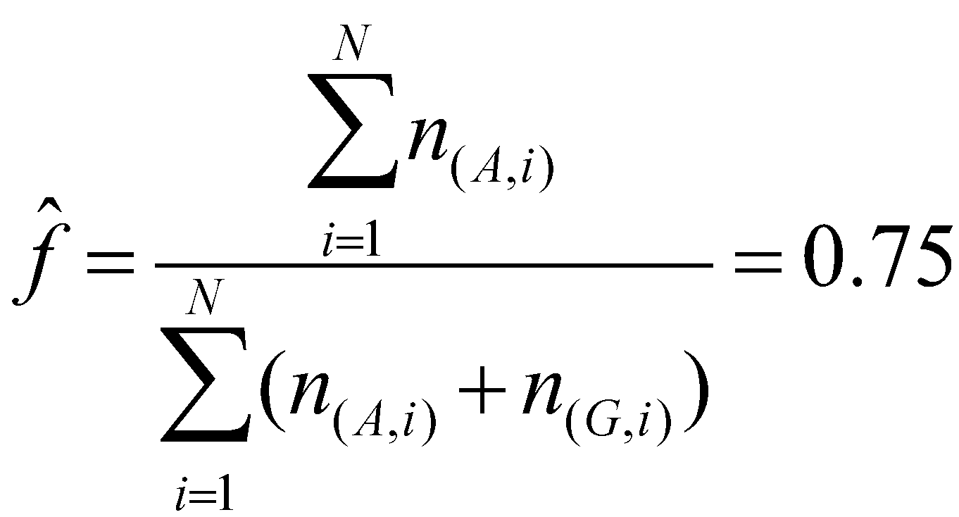
Estimating allele frequencies
Individual | True genotype | Reads allele A | Reads allele G
1 | AA | 7 | 0
2 | AA | 25 | 1
3 | AG | 5 | 3
4 | AG | 4 | 4
5 | GG | 0 | 2
6 | GG | 0 | 4
Tot. |  | 41 | 14
Simple allele frequency estimator:
from reads counts

Slide 87
Estimating allele frequencies
Individual | True genotype | Reads allele A | Reads allele G
1 | AA | 7 | 0
2 | AA | 25 | 1
3 | AG | 5 | 3
4 | AG | 4 | 4
5 | GG | 0 | 2
6 | GG | 0 | 4
Tot. |  | 41 | 14
Simple allele frequency estimator:
from reads counts

Slide 88
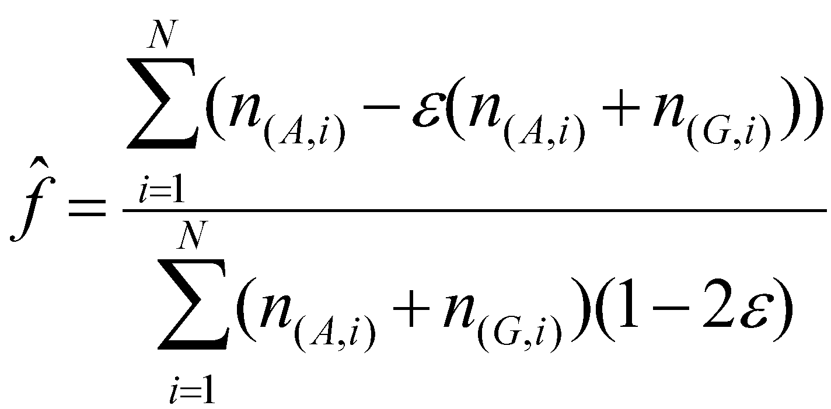
Estimating allele frequencies
Individual | True genotype | Reads allele A | Reads allele G
1 | AA | 7 | 0
2 | AA | 25 | 1
3 | AG | 5 | 3
4 | AG | 4 | 4
5 | GG | 0 | 2
6 | GG | 0 | 4
Tot. |  | 41 | 14
Simple allele frequency estimator:
from reads counts with error

Slide 89
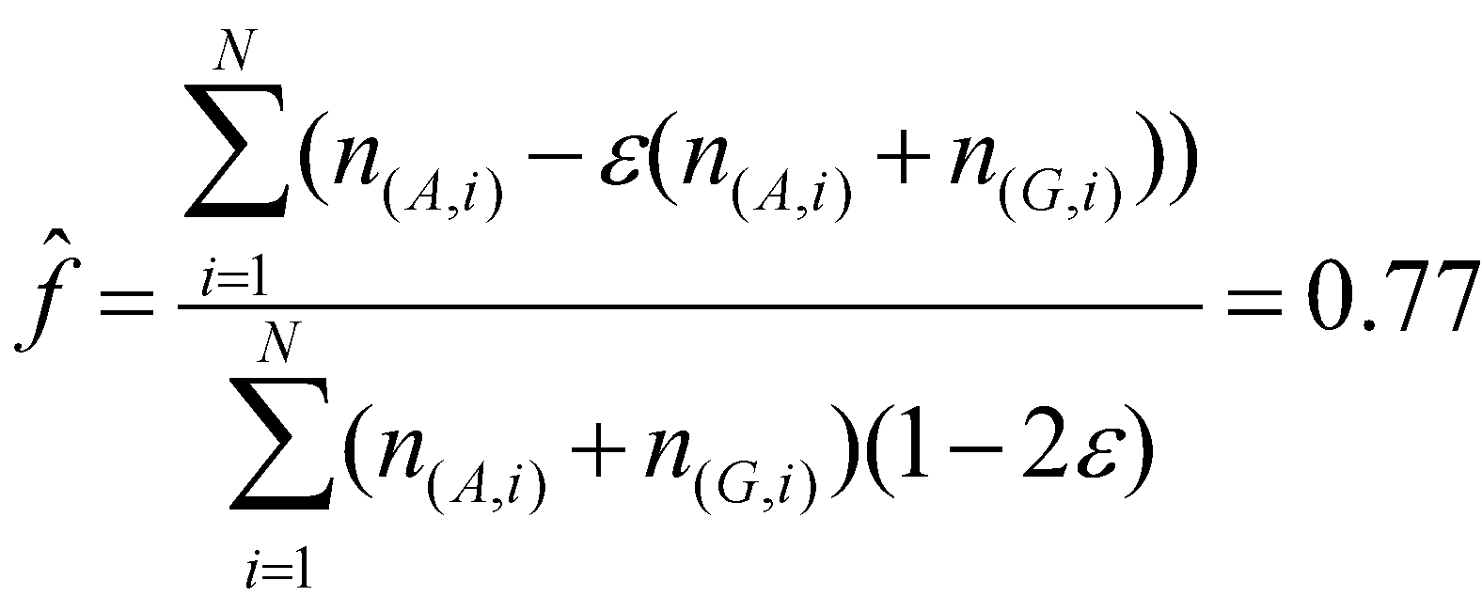
Estimating allele frequencies
Individual | True genotype | Reads allele A | Reads allele G
1 | AA | 7 | 0
2 | AA | 25 | 1
3 | AG | 5 | 3
4 | AG | 4 | 4
5 | GG | 0 | 2
6 | GG | 0 | 4
Tot. |  | 41 | 14
Simple allele frequency estimator:
from reads counts with error

Slide 90
Estimating allele frequencies
Individual | True genotype | Reads allele A | Reads allele G
1 | AA | 7 | 0
2 | AA | 25 | 1
3 | AG | 5 | 3
4 | AG | 4 | 4
5 | GG | 0 | 2
6 | GG | 0 | 4
Tot. |  | 41 | 14
Simple allele frequency estimator:
from reads counts with error

Slide 91
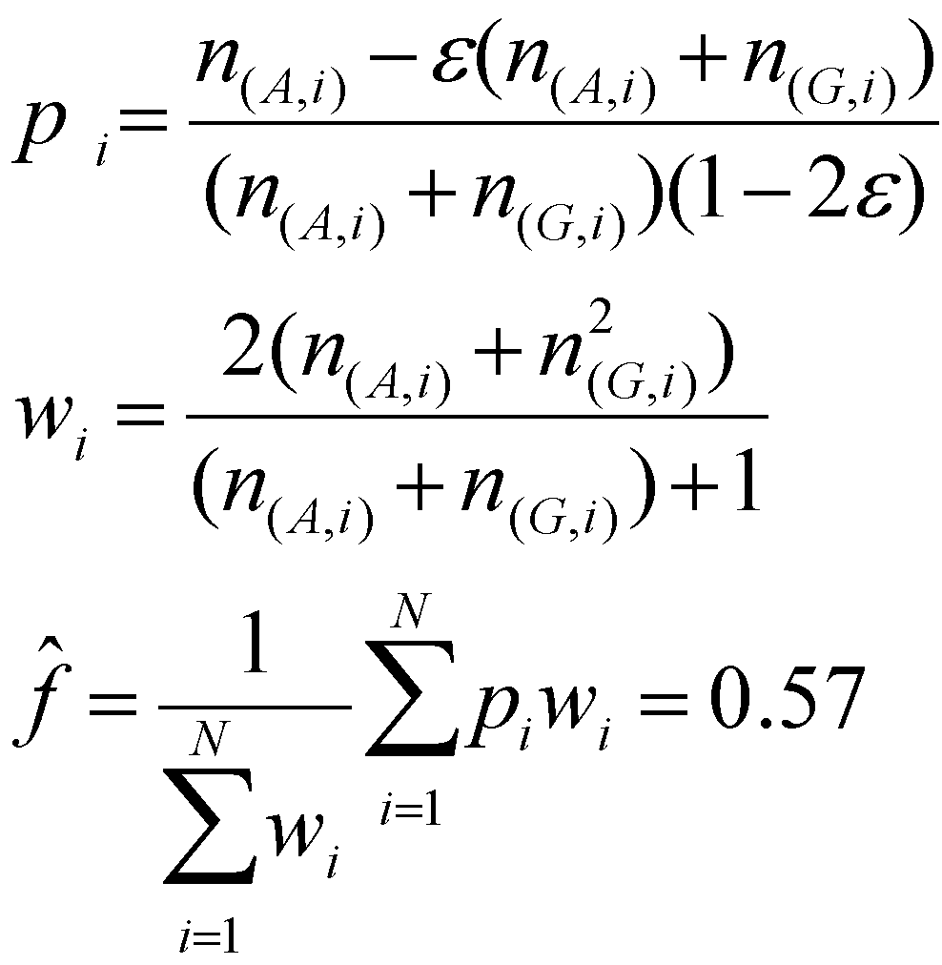
Estimating allele frequencies
Simple allele frequency estimator:
from reads counts with error and weights (Y Li et al. 2010)
Individual | True genotype | Reads allele A | Reads allele G
1 | AA | 7 | 0
2 | AA | 25 | 1
3 | AG | 5 | 3
4 | AG | 4 | 4
5 | GG | 0 | 2
6 | GG | 0 | 4
Tot. |  | 41 | 14
Notes:
Wi is scaled inverse of variance of pi

Slide 92

Estimating allele frequencies
Maximum Likelihood (ML) estimator (Kim et al. 2011)
Individual | True genotype | Reads allele A | Reads allele G
1 | AA | 7 | 0
2 | AA | 25 | 1
3 | AG | 5 | 3
4 | AG | 4 | 4
5 | GG | 0 | 2
6 | GG | 0 | 4
Tot. |  | 41 | 14
Notes:
Wi is scaled inverse of variance of pi

Slide 93

Estimating allele frequencies
Maximum Likelihood (ML) estimator (Kim et al. 2011)
Notes:
Wi is scaled inverse of variance of pi

Slide 94
Estimating allele frequencies
Maximum Likelihood (ML) estimator (Kim et al. 2011)
Notes:
Wi is scaled inverse of variance of pi

Slide 95
Estimating allele frequencies
Maximum Likelihood (ML) estimator (Kim et al. 2011)
Genotype likelihoods
Notes:
Wi is scaled inverse of variance of pi

Slide 96

Estimating allele frequencies
Maximum Likelihood (ML) estimator (Kim et al. 2011)
Genotype likelihoods
If we assume HWE:
Notes:
Wi is scaled inverse of variance of pi

Slide 97

Estimating allele frequencies
Maximum Likelihood (ML) estimator (Kim et al. 2011)
Individual | True genotype | Reads allele A | Reads allele G
1 | AA | 7 | 0
2 | AA | 25 | 1
3 | AG | 5 | 3
4 | AG | 4 | 4
5 | GG | 0 | 2
6 | GG | 0 | 4
Tot. |  | 41 | 14
Notes:
Wi is scaled inverse of variance of pi

Slide 98
Workflow
Low-level data:
Samples preparation + sequencing
Call bases and quality scores
Genotype data:
Call genotypes
Estimate allele frequencies
SNPs detection
Analysis:
Population genetics analysis
Association studies

Slide 99
SNP calling
A lot of missing data if calling genotypes at low depth (heterozygotes can be lost!)
Rare variants are hard to detect
Trade-off between False Positives and False Negatives

Slide 100
SNP calling – effect of errors
Calling SNPs if 2 alternate alleles are observed (5X and 100 samples and error rate of 0.01):
False positive rate?

Slide 101
SNP calling – effect of errors
Calling SNPs if 2 alternate alleles are observed (5X and 100 samples and error rate of 0.01):
False positive rate? >99%

Slide 102
SNP calling – effect of errors
Calling SNPs if 2 alternate alleles are observed (5X and 100 samples and error rate of 0.01):
False positive rate? >99%
Heavy filtering of data (error rate of 0.001):
False positive rate?

Slide 103
SNP calling – effect of errors
Calling SNPs if 2 alternate alleles are observed (5X and 100 samples and error rate of 0.01):
False positive rate? >99%
Heavy filtering of data (error rate of 0.001):
False positive rate? 60%
Numbers from R. Nielsen’s slide

Slide 104
SNP calling
What is the most straightforward method to for SNP calling?

Slide 105
SNP calling
What is the most straightforward method to for SNP calling?
Assign as SNPs sites where at least one heterozygote has been called
…

Slide 106
SNP calling
What is the most straightforward method to for SNP calling?
Assign as SNPs sites where at least one heterozygote has been called
Assign as SNPs sites where the estimated allele frequency is above a certain threshold (e.g. ?)

Slide 107

SNP calling
MLE of allele frequency at each site:
Call a SNP if
Where t can be defined as the minimum sample allele frequency detectable (e.g. with 10 samples t can be set to 0.05)

Slide 108

SNP calling
Likelihood Ratio Test (LRT): test statistical hypotheses based on comparing the maximum likelihood under 2 different models.
T is chi-squared distributed with 1 degree of freedom -> assign a p-value

Slide 109
Workflow
Low-level data:
Samples preparation + sequencing
Call bases and quality scores
Genotype data:
Call genotypes
Estimate allele frequencies
SNPs detection
Population genetics analysis:
Site Frequency Spectrum
Summary statistics

Slide 110
Site Frequency Spectrum (SFS)

Slide 111

Effect of errors on SFS

Slide 112

Effect of errors on SFS
Using an ad hoc fixed cutoff for SNP calling…
can never produce unbiased estimates.

Slide 113

Effects of low-depth data
Nucleotide diversity scan using 1000 Genomes Project data (low-depth)
Cagliani et al. MBE. 2012

Slide 114
Effects of low-depth data
Nucleotide diversity scan using 1000 Genomes Project data (low-depth)
Highest peak based on Sanger sequencing!
Cagliani et al. MBE 2012

Slide 115

Effects of low-depth data
Sanger: detected a total of 24 variants
NGS: only 13
Most of them (n=8) have intermediate
frequency in all populations.
They are located within an AluSx element
in the 3'UTR.
A large portion of “inaccessible
Sites” in the low-depth1000 Genomes
data maps to repetitive sequences.
Cagliani et al. MBE 2012

Slide 116

Masked data
Highest peak recovered
Missing data
Unpredictable effects
Cagliani et al. MBE 2012

Slide 117

Maximum Likelihood Estimation (MLE) of the Site Frequency Spectrum
Parameterize the SFS, with k individuals
If unfolded, ? entries
If folded, ? entries

Slide 118
Maximum Likelihood Estimation (MLE) of the Site Frequency Spectrum
Parameterize the SFS, with k individuals
If unfolded, 2k+1 entries
If folded, 2k entries
p₀ | p₁ | p₂ | p₃ | … | p_{2k}
p₀ | p₁ | p₂ | … | p_{k}

Slide 119

ML estimation of the SFS
Summing across all unknown genotypes and multiplying the likelihood across sites.
Likelihood function:
Nielsen et al. 2012 PLoS One

Slide 120

ML estimation of the SFS
Simulated 30Mb
Error rate of 0.3%
Mean depth of 5X
TRUE
MLE
MLE, 6 regions combined

Slide 121

ML estimation of the SFS
Simulated 30Mb
Error rate of 0.3%
Mean depth of 5X
Mean depth of 1X:
TRUE
MLE
MLE, 6 regions combined
R. Nielsen’s slide

Slide 122
ML estimation of the SFS
Can be used for:
SNP calling
Genotype calling
Modeling uncertainty in population genetics analyses

Slide 123
Workflow
Low-level data:
Samples preparation + sequencing
Call bases and quality scores
Genotype data:
Call genotypes
Estimate allele frequencies
SNPs detection
Population genetics analysis:
Site Frequency Spectrum
Summary Statistics

Slide 124
Sample allele frequency posterior probabilities
S_{m}: sample allele frequency at site m
Likelihood
Prior
p(S_{m}=0) | p(S_{m}=1) | p(S_{m}=2) | p(S_{m}=3) | … | p(S_{m}=2k)

Slide 125
Sample allele frequency posterior probabilities
S_{m}: sample allele frequency at site m
Likelihood
Prior
Estimate of the overall SFS
p(S_{m}=0) | p(S_{m}=1) | p(S_{m}=2) | p(S_{m}=3) | … | p(S_{m}=2k)

Slide 126
Sample allele frequency posterior probabilities
p(S_{m}=0) | p(S_{m}=1) | p(S_{m}=2) | p(S_{m}=3) | … | p(S_{m}=2k)
Estimating allele frequency

Slide 127
Expected value
The expected value of a discrete random variable is the probability-weighted average of all possible values
Average value if you perform the same experiment many times
It is the value that one could expect on average

Slide 128

Sample allele frequency posterior probabilities
p(S_{m}=0) | p(S_{m}=1) | p(S_{m}=2) | p(S_{m}=3) | … | p(S_{m}=2k)
Estimating allele frequency
Used as prior for genotype calling

Slide 129
Sample allele frequency posterior probabilities
p(S_{m}=0) | p(S_{m}=1) | p(S_{m}=2) | p(S_{m}=3) | … | p(S_{m}=2k)
Estimating allele frequency
Used as prior for genotype calling

Slide 130

Sample allele frequency posterior probabilities
p(S_{m}=0) | p(S_{m}=1) | p(S_{m}=2) | p(S_{m}=3) | … | p(S_{m}=2k)
SNP calling
with t being 0.05, 0.01., 0.001 and so on.

Slide 131

Sample allele frequency posterior probabilities
p(S_{m}=0) | p(S_{m}=1) | p(S_{m}=2) | p(S_{m}=3) | … | p(S_{m}=2k)
SNP calling
with t being 0.05, 0.01., 0.001 and so on.

Slide 132
Nr of segregating sites
Site 1
Site 2
Site 3
…
Site M
p(S_{m}=0) | p(S_{m}=1) | p(S_{m}=2) | p(S_{m}=3) | … | p(S_{m}=2k)
p(S_{m}=0) | p(S_{m}=1) | p(S_{m}=2) | p(S_{m}=3) | … | p(S_{m}=2k)
p(S_{m}=0) | p(S_{m}=1) | p(S_{m}=2) | p(S_{m}=3) | … | p(S_{m}=2k)
p(S_{m}=0) | p(S_{m}=1) | p(S_{m}=2) | p(S_{m}=3) | … | p(S_{m}=2k)

Slide 133
Nr of segregating sites
Site 1
Site 2
Site 3
…
Site M
p(S_{m}=0) | p(S_{m}=1) | p(S_{m}=2) | p(S_{m}=3) | … | p(S_{m}=2k)
p(S_{m}=0) | p(S_{m}=1) | p(S_{m}=2) | p(S_{m}=3) | … | p(S_{m}=2k)
p(S_{m}=0) | p(S_{m}=1) | p(S_{m}=2) | p(S_{m}=3) | … | p(S_{m}=2k)
p(S_{m}=0) | p(S_{m}=1) | p(S_{m}=2) | p(S_{m}=3) | … | p(S_{m}=2k)

Slide 134

Nr of segregating sites
Site 1
Site 2
Site 3
…
Site M
p(S_{m}=0) | p(S_{m}=1) | p(S_{m}=2) | p(S_{m}=3) | … | p(S_{m}=2k)
p(S_{m}=0) | p(S_{m}=1) | p(S_{m}=2) | p(S_{m}=3) | … | p(S_{m}=2k)
p(S_{m}=0) | p(S_{m}=1) | p(S_{m}=2) | p(S_{m}=3) | … | p(S_{m}=2k)
p(S_{m}=0) | p(S_{m}=1) | p(S_{m}=2) | p(S_{m}=3) | … | p(S_{m}=2k)

Slide 135

Nucleotide diversity
Site 1
Site 2
Site 3
…
Site M
p(S_{m}=0) | p(S_{m}=1) | p(S_{m}=2) | p(S_{m}=3) | … | p(S_{m}=2k)
p(S_{m}=0) | p(S_{m}=1) | p(S_{m}=2) | p(S_{m}=3) | … | p(S_{m}=2k)
p(S_{m}=0) | p(S_{m}=1) | p(S_{m}=2) | p(S_{m}=3) | … | p(S_{m}=2k)
p(S_{m}=0) | p(S_{m}=1) | p(S_{m}=2) | p(S_{m}=3) | … | p(S_{m}=2k)

Slide 136

Nucleotide diversity
Site 1
Site 2
Site 3
…
Site M
p(S_{m}=0) | p(S_{m}=1) | p(S_{m}=2) | p(S_{m}=3) | … | p(S_{m}=2k)
p(S_{m}=0) | p(S_{m}=1) | p(S_{m}=2) | p(S_{m}=3) | … | p(S_{m}=2k)
p(S_{m}=0) | p(S_{m}=1) | p(S_{m}=2) | p(S_{m}=3) | … | p(S_{m}=2k)
p(S_{m}=0) | p(S_{m}=1) | p(S_{m}=2) | p(S_{m}=3) | … | p(S_{m}=2k)

Slide 137








Applications
Model and non-model species
Plants
Vertebrates and invertebrates
Ancient DNA
…

Slide 138
Software
Such advanced methods have been implemented in several software and utilities, such as:
ANGSD (http://popgen.dk/ANGSD)
ngsTools (https://github.com/mfumagalli/ngsTools)
http://jnpopgen.org/software/
which we will explore during the practical session.

Slide 139
Summary
SNP calling should be performed including information from all samples (and inbreeding coefficient estimates, if relevant)
Probabilistic methods for estimation of allele frequencies and statistics should be preferred (especially for mean sequencing depth < 20X)

Slide 140
References
Nielsen et al. Nat Rev Genet 2011 (21587300)
Li H. Bioinformatics 2011 (21903627)
Kim et al. BMC Bioinformatics 2011 (21663684)
Fumagalli M. PLoS One 2013 (24260275)
* PubMed ID: http://www.ncbi.nlm.nih.gov/pubmed/*

Slide 141
Practical exercises
Estimating allele frequencies
SNP calling
Estimating the Site Frequency Spectrum
Estimating summary statistics

Slide 142


Paper(s) discussion

Slide 143

Experimental design
You discovered a new species!

Slide 144
Experimental design
Population of 1,000 individuals

Slide 145

Experimental design
...

Slide 146

Experimental design
...

Slide 147

Experimental design

Slide 148

Experimental design

Slide 149
Experimental design
At a fixed budget:
sequencing more samples will lower the per-sample sequencing depth, and, as a consequence, increase the genotype uncertainty.
higher sequencing coverage will decrease genotyping uncertainty, but will also restrict the analysis to a smaller sample of individuals, which may be a poor representation of the genomic variation of the entire population

Slide 150

Experimental design
At a fixed budget:
sequencing more samples will lower the per-sample sequencing depth, and, as a consequence, increase the genotype uncertainty.
higher sequencing coverage will decrease genotyping uncertainty, but will also restrict the analysis to a smaller sample of individuals, which may be a poor representation of the genomic variation of the entire population

Slide 151

Experimental design
At a fixed budget:
sequencing more samples will lower the per-sample sequencing depth, and, as a consequence, increase the genotype uncertainty.
higher sequencing coverage will decrease genotyping uncertainty, but will also restrict the analysis to a smaller sample of individuals, which may be a poor representation of the genomic variation of the entire population

Slide 152
Simulations design
The sequencing strategy can easily be modelled in terms of the number of sequenced samples and the per-sample sequencing depth.
Sample size | Per-sample depth
1,000 | 1X
500 | 2X
100 | 10X
20 | 50X
total depth is 1,000X

Slide 153


Simulations design
Assess the bias in the estimation

Slide 154


Slide 156


Slide 158

SNP calling

Slide 159
SNP calling

Slide 160
SNP calling

Slide 161

Question for discussion - 1
SNP is assigned if allele frequency is > 1/(2N)
SNP is assigned if ?

Slide 162
Question for discussion - 1
SNP is assigned if allele frequency is > 1/(2N)
SNP is assigned if the probability of being variable is > 0.95

Slide 163
Conclusions
The results suggest that at a fixed sequencing budget, it is desirable to sequence a large number of individuals, at the cost of reducing the per-sample sequencing depth.
To estimate allele frequencies and identify polymorphic sites, sequencing the largest possible sample size with at least a per-sample sequencing depth of 2X is recommended.
State-of-the-art statistical methods to estimate genetic variation from NGS data should be adopted in all population genetics studies using low-medium coverage sequencing data.

Slide 164


Practical session
Inuit
Raghavan et al. 2015 Science

